Slide 1


General Biology
Lecture 3
Dr. Rawa Abdul Redha Aziz
Ph.D Antibiotics/ Molecular biology

Slide 2
The kingdom of living organisms
All living organisms are classified into groups based on very basic, shared characteristics
Organisms within each group are then further divided into smaller groups. These smaller groups are based on more detailed similarities within each larger group.
Characteristics such as appearance, reproduction, mobility, and functionality are just a few ways in which living organisms are grouped together. These specialized groups are collectively called the classification of living things. The classification of living things includes 7 categories: (kingdom, phylum, class, order, family, genus, and species).
The classification has many uses first; it helps scientists to sort organisms in order. Second, it helps them to identify new organisms by finding out which group they fit. Third, it is easier to study organisms when they are sorted in groups.

Slide 3
Categories of classification of organisms
Kingdoms: The most basic classification of living things is kingdoms. Currently there are five kingdoms. Living things are placed into certain kingdoms based on how they obtain their food, the types of cells that make up their body, and the number of cells they contain.
Phylum: The next level following kingdom in the classification of living things. It is an attempt to find some kind of physical similarities among organisms within a kingdom. These physical similarities suggest that there is a common ancestry among those organisms in a particular phylum.
Class: A taxonomic group comprised of organisms that share a common attribute. It is further divided into one or more orders.
Order: A taxonomic rank used in classifying organisms, generally below the class, and comprised of families

Slide 4
Family: A taxonomic rank in the classification of organisms between genus and order includes one or more genera, especially sharing a common attribute.
Genus: A taxonomic category ranking used in biological classification that is below a family and above a species level, and includes group of species that are structurally similar or phylogenetically related.
Species: The lowest taxonomic rank, and the most basic unit or category of biological classification.

Slide 5
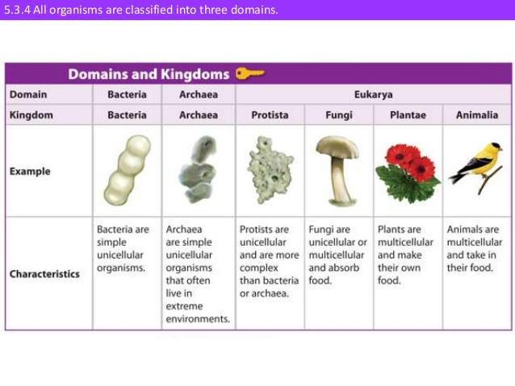

Slide 6

Binomial system of naming species
Carl Linnaeus, a Swedish botanist gave every species a scientific name in Latin. The binomial system of naming species means giving organisms two names in Latin (scientific names). The term binomial literally means two names Linnaeus derived scientific names from the genus and the species to which organisms belong.
When writing a scientific name, the genus name is written first and starts with a capital letter, and the species name is written second and starts with a small letter. The scientific name ought to be printed in italics when typed and underlined separately when handwritten. The tiger belongs to the genus called Panthera and the species called tigris, therefore its scientific name will be typed as Panthera tigris, or handwritten as Panthera tigris.

Slide 7
In 1735 Linnaeus in his classification scheme, recognized only two kingdoms of living things: Animalia and Plantae. At the time, microscopic organisms had not been studied in detail. Either they were placed in a separate category or in some cases, they were classified with plants or animals.
Then in 1860, the German investigator Ernst Haeckel proposed a three-kingdom system of classification. Haeckel’s three kingdoms were Animalia, Plantae, and Protista. Members of the kingdom Protista included the protozoa, fungi, bacteria, and other microorganisms. Haeckel’s system was not widely accepted, however, and microorganisms continued to be classified as plants (for example, bacteria and fungi) or animals (for example, protozoa).

Slide 8
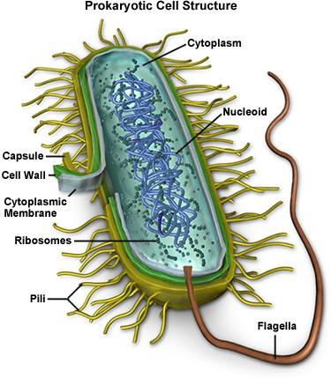
Kingdom Monera: (includes Eubacteria and Archeobacteria) Individuals are single-celled, may or may not move, have a cell wall, have no chloroplasts or other organelles, and have no nucleus. Monera are usually very tiny, although one type, namely the blue-green bacteria, look like algae. They are filamentous and quite long, green, but have no visible structure inside the cells. No visible feeding mechanism. They absorb nutrients through the cell wall or produce their own by photosynthesis.

Slide 9
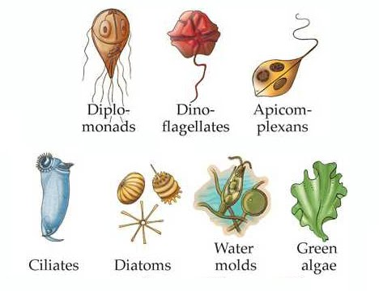
Kingdom Protista: they are single-celled and usually move by cilia, flagella, or by amoeboid mechanisms. There is usually no cell wall, although some forms may have a cell wall. They have organelles including a nucleus and may have chloroplasts, so some will be green and others won't be. They are small, although many are big enough to be recognized in a dissecting microscope or even with a magnifying glass. Nutrients are acquired by photosynthesis, ingestion of other organisms, or both.

Slide 10
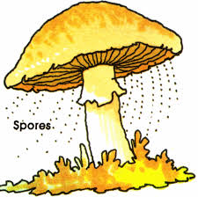
Kingdom Fungi: They are multicellular, with a cell wall, organelles including a nucleus, but no chloroplasts. They have no mechanisms for locomotion. Fungi range in size from microscopic to very large such as mushrooms. Nutrients are acquired by absorption. For the most part, fungi acquire nutrients from decaying material

Slide 11
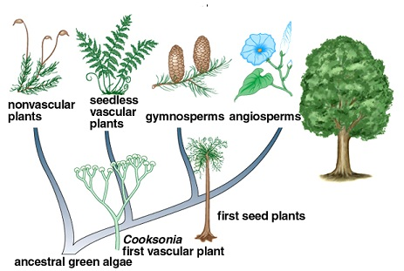
Kingdom Plantae: Plants are multicellular and most don't move, although gametes of some plants move using cilia or flagella. Organelles including nucleus, chloroplasts are present, and cell walls are present. Nutrients are acquired by photosynthesis (they all require sunlight).

Slide 12
Kingdom Animalia : They includes animals without backbones (invertebrates) and with backbones (vertebrates). The cells are eukaryotic; the organisms are heterotrophic. Animals are multicellular, and move with the aid of cilia, flagella, or muscular organs based on contractile proteins. They have organelles including a nucleus, but no chloroplasts or cell walls. The feeding form is one in which large molecules from the external environment are consumed and then broken down to usable parts in the animal body.

Slide 13

Any Question?

